Slide 1
Learning Document Structure for Retrieval And Classification
Chinmay Garg (B16CS041)
Anurag Shah (B16CS034)
Under the guidance of Dr. Gaurav harit

Slide 2
Objective
To retrieve “similar” documents from a large heterogeneous collection of document images.
Sub-objective:
To classify the Arabic dataset provided on the basis that whether they contain a table or not.

Slide 3
Approach
Recursively partition the image horizontally and vertically.
Compute a histogram of codewords in each partition. (or learned codewords)
Using a random forest classifier on the set of features of the image.
This gives a high precision and re-call for retrieval of:
Hand drawn documents
Machine printable documents
Unconstrained mixed form type documents

Slide 4
01
02
Codebook Creation
Writing Features
05
03
Classification of Images
Cross Validation
04
Training the RF

Slide 5
01
02
CODEBOOK CREATION
Get 64-dimensioned descriptors for the images in the dataset.
Number of descriptors for each image will depend on the hessian threshold and the image itself.
Out of all the descriptors 100 will be chosen using k-means algorithm.
These 100 descriptors will be stored in the codebook.
05
03
04

Slide 6
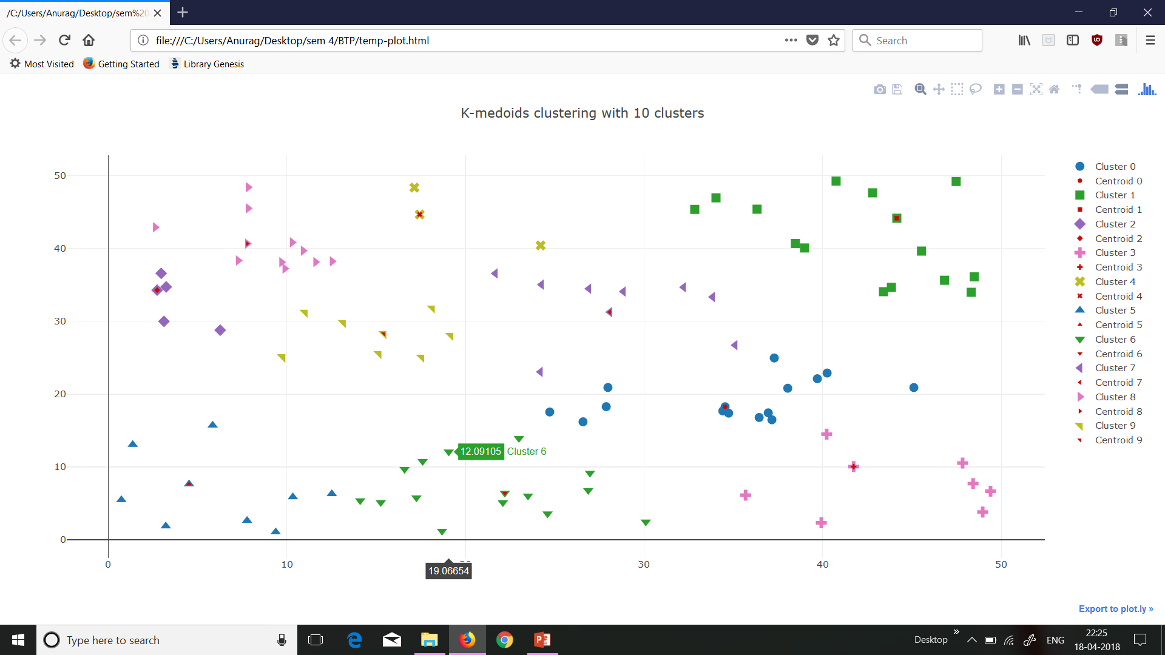

Slide 7
01
02
WRITING FEATURES
In this steps we get 13 partitions for each image and then compute a histogram for each partition.
Each histogram is computed against the 100 codewords (clusters) we obtained in last steps.
Therefore, we have 13*100 = 1300 features for each image.
05
03
04

Slide 8
PARTITIONS
2
3
6
7
8
9
1
10
4
11
12
5
13

Slide 9
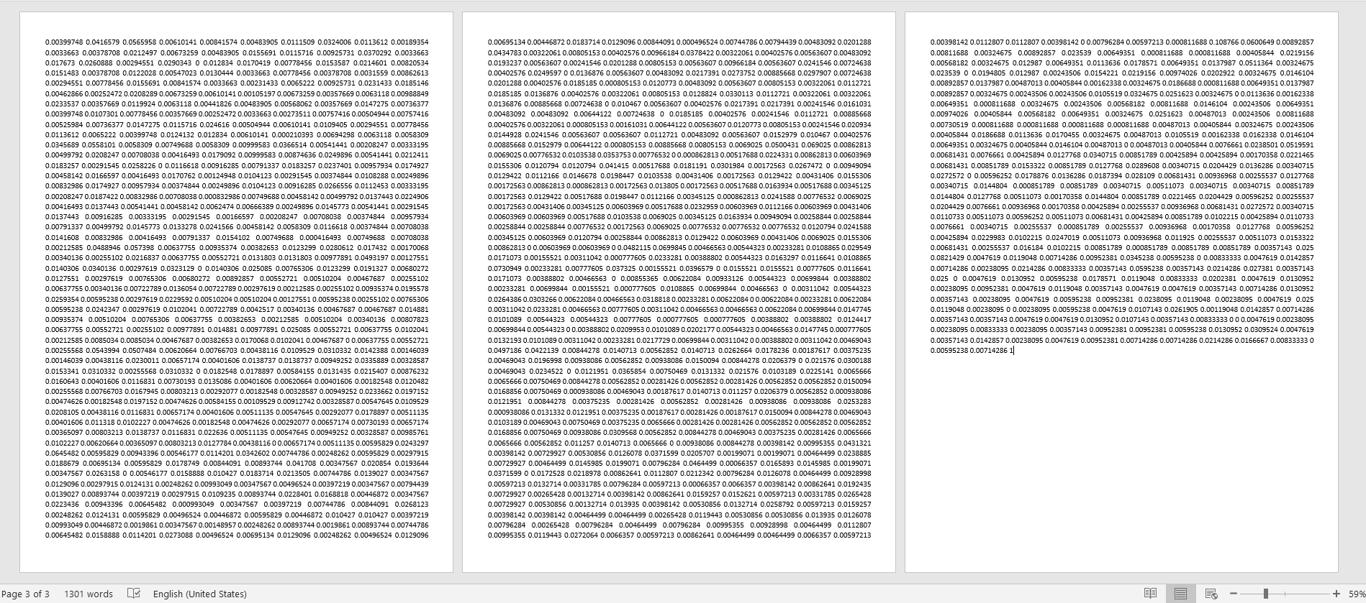

Slide 10
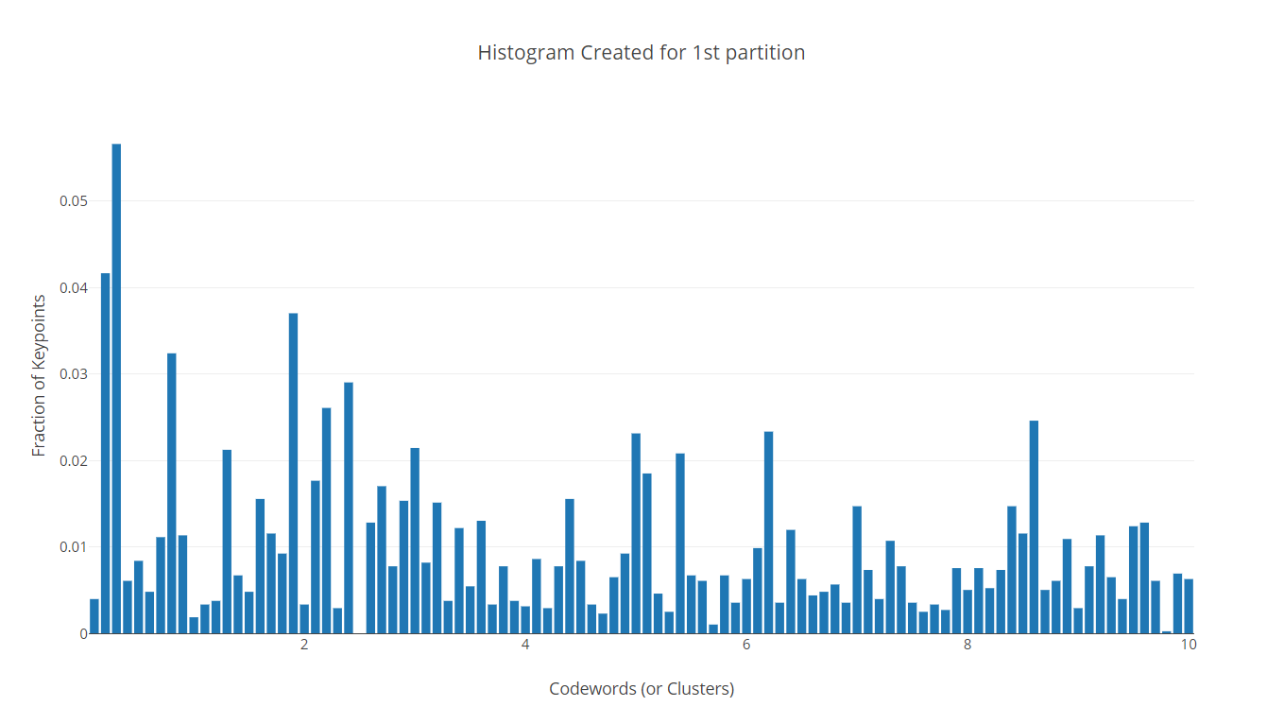

Slide 11
01
02
CROSS VALIDATION
From the dataset we train the random forest with randomly chosen 300 images and then test it with other left images.
We repeat the process 10 times and obtain the median accuracy.
05
03
04

Slide 12
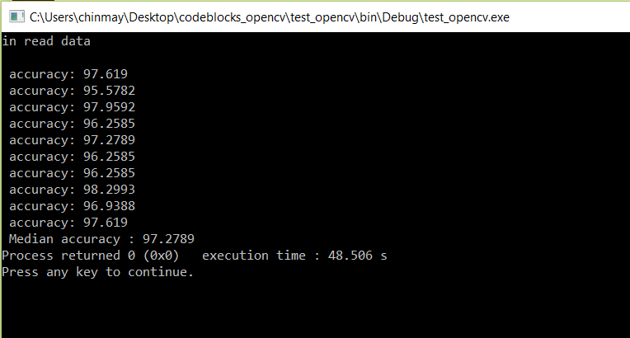

Slide 13
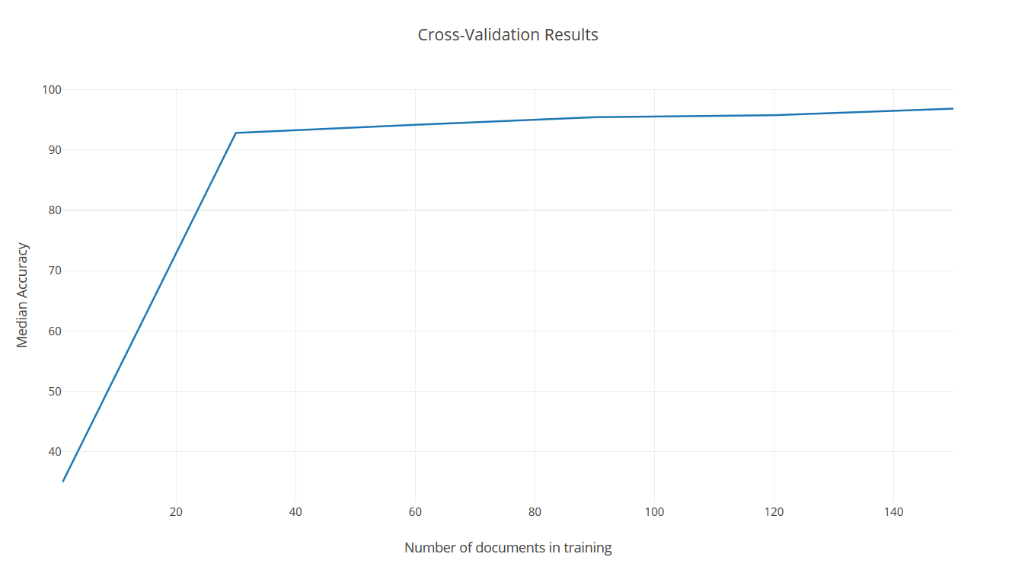

Slide 14
01
02
TRAINING THE RANDOM FOREST
We have to train the random forest (in other words generate it).
And save the model of the random forest in a .txt file.
05
03
04

Slide 15
Random forest classifier
Random forest classifier creates a set of decision trees from randomly selected subset of training set.
It then aggregates the votes from different decision trees to decide the final class of the test object.

Slide 16
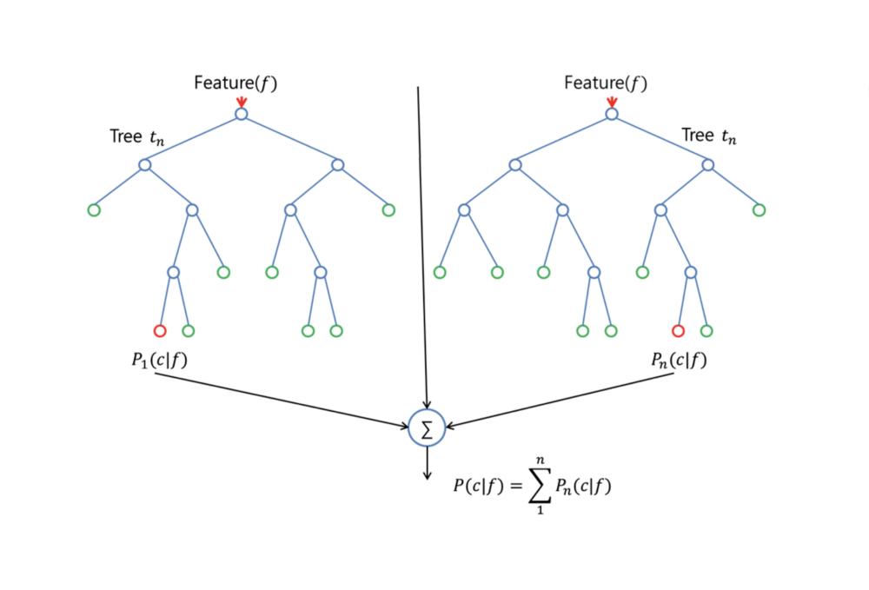

Slide 17
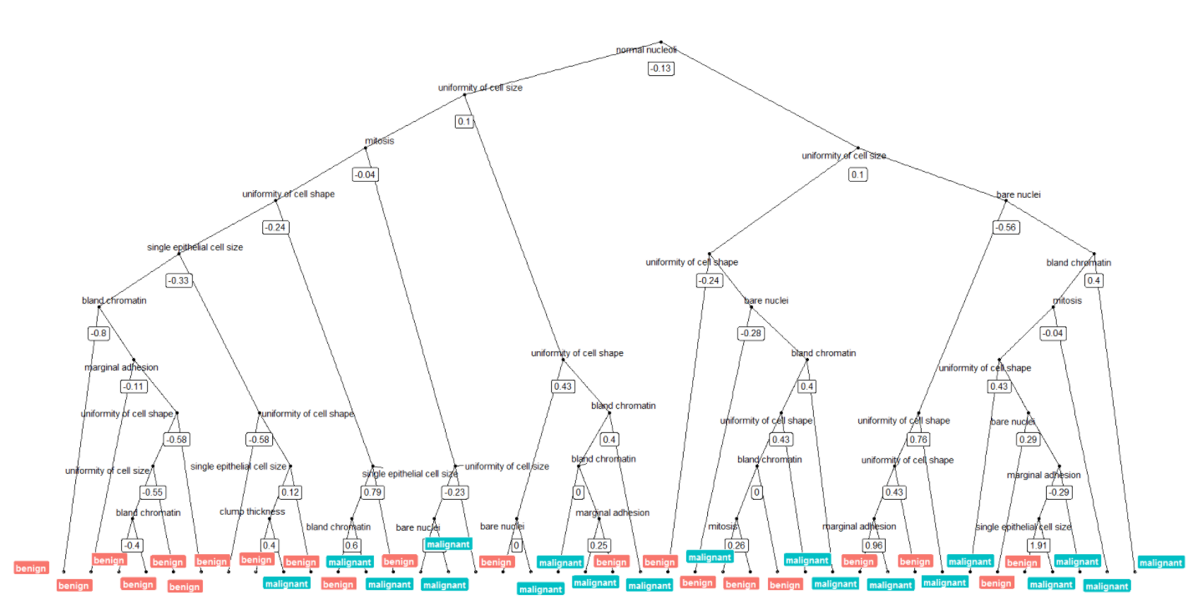

Slide 18
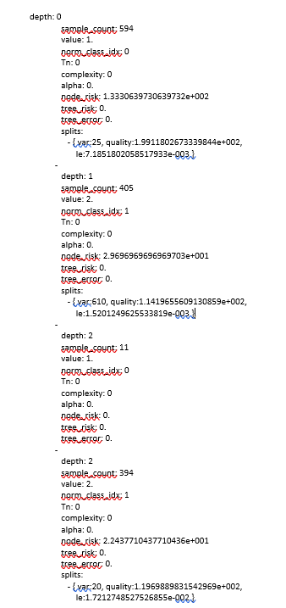

Slide 19
01
02
CLASSIFICATION OF IMAGES
Compute the histogram for the input image. (already have been described)
Load the random forest from model.txt.
Predict the class of the image using random forest.
05
03
04

Slide 20
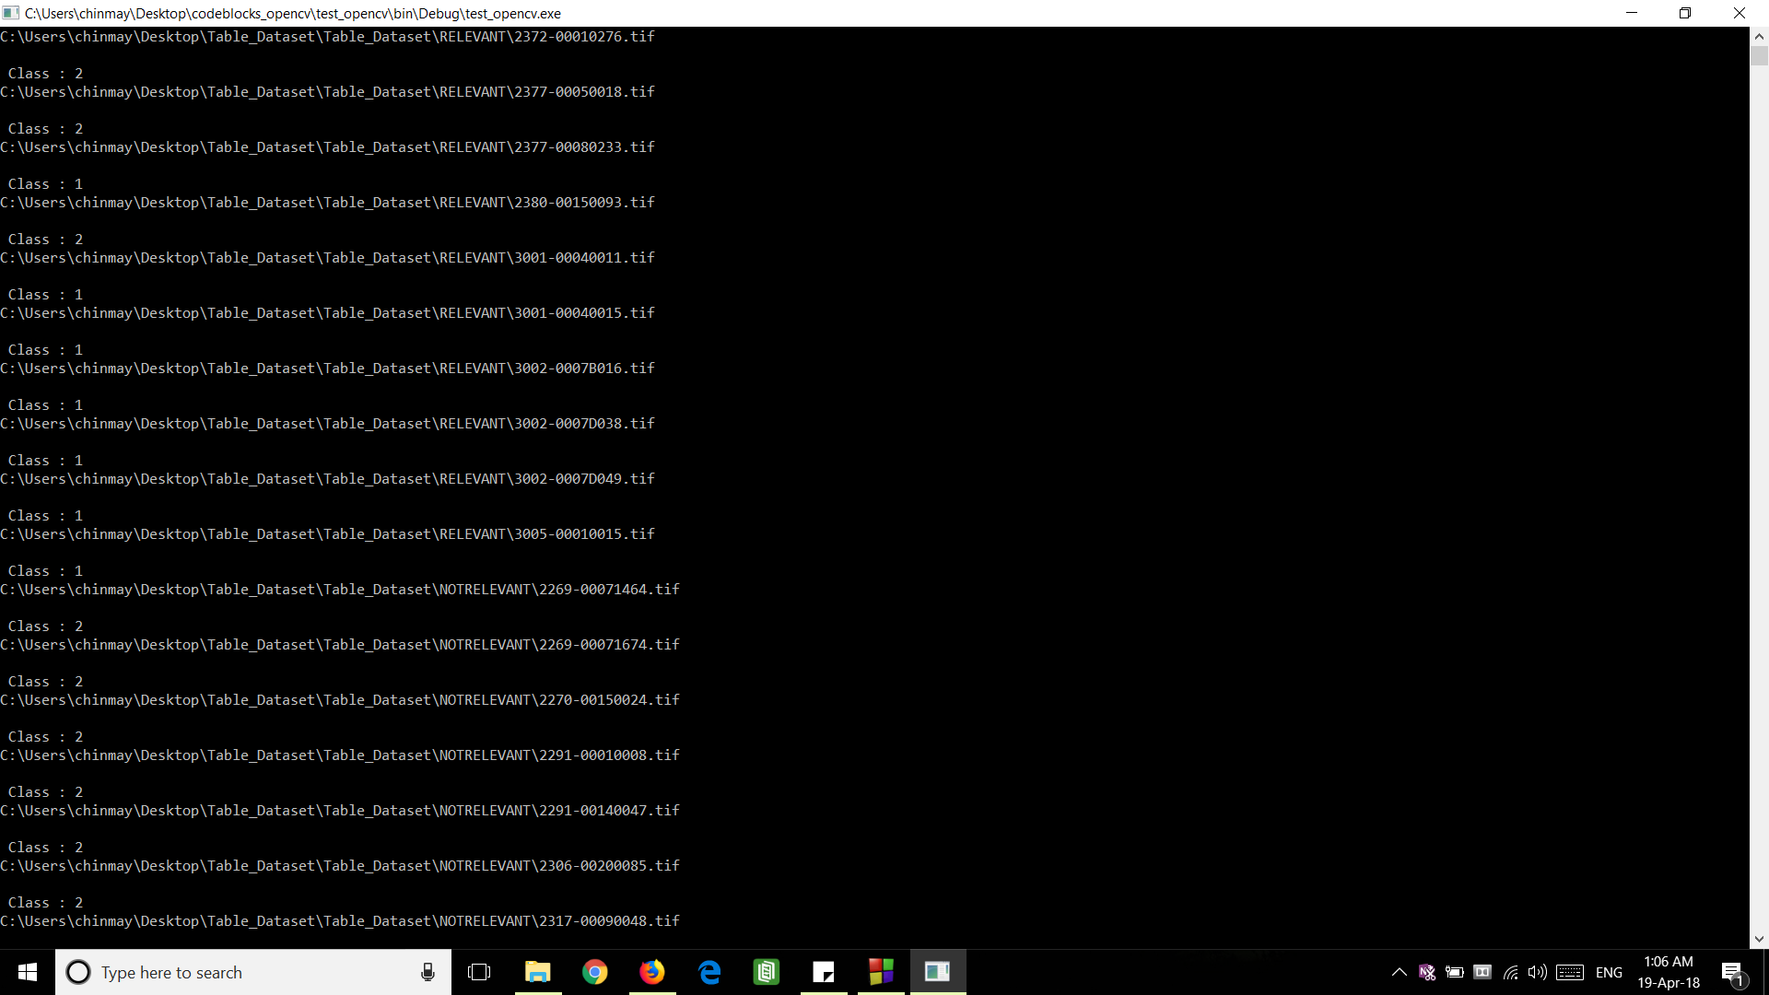

Slide 21
The 3 images which were identified incorrectly

Slide 22
Two images that were correctly classified but were not the part of the dataset

Slide 23
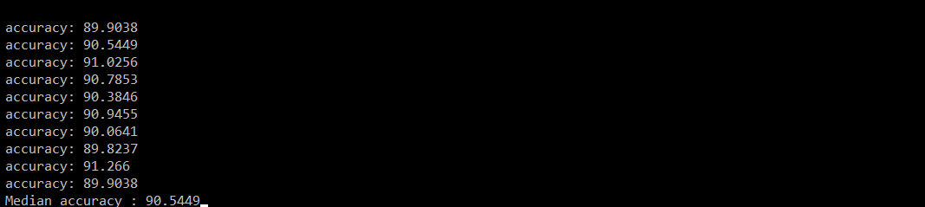
For pentamery classification
CLASSES:
Table
Advertisement
E-Mail
Form
Letter

Slide 24
Learning outcomes
Implementation of OpenCV libraries in C++.
Knowledge of algorithms like SURF, K-means and Random Forest.
Got to know how machine learning looks like.

Slide 25
Conclusion
The algorithm proposed in the paper was successfully implemented.
The accuracy obtained was exactly as expected in the paper (97.2%).
Efficiency of HVP and RFC were successfully tested.
More importantly we got our first brush with machine learning, document page segmentation, document classification and OpenCV libraries.

Slide 26
Thank you

Slide 27

INTO THE CODE

Slide 28
CODEBOOK CREATION
Class ImageBasedCodeBook
Member Functions:
int addDescMatrix( const CvSeq* model_keypoints, const CvSeq* model_descriptors, int descSize = 64)
int CreateCodeBook(const char* image_filename, const char* codebook_filename, int clusterCount = 100)

Slide 29
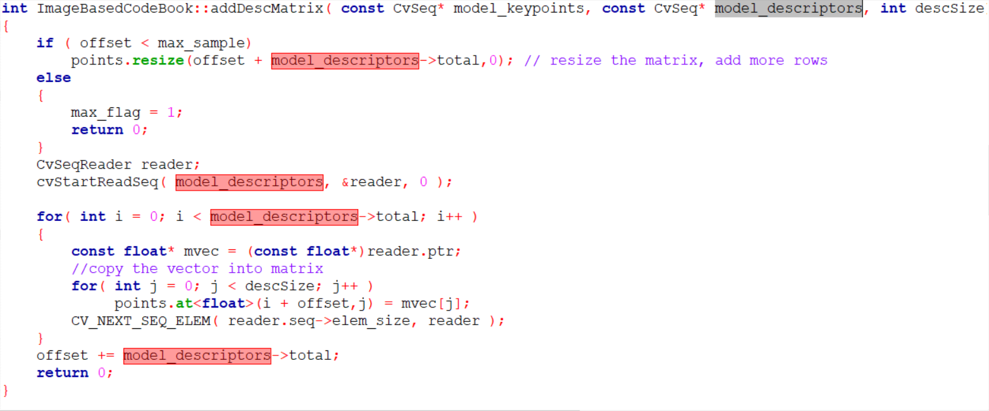
int addDescMatrix( const CvSeq* model_keypoints, const CvSeq* model_descriptors, int descSize = 64)
This function is used to store all the descriptors of an image in point(member variable) which is of type Mat.

Slide 30
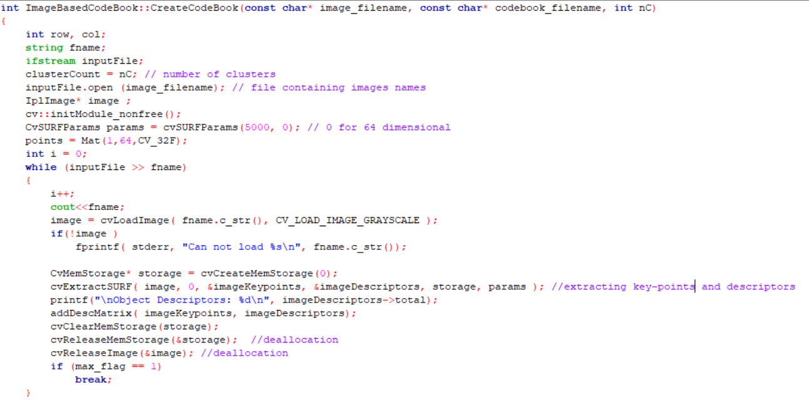
int CreateCodeBook(const char* image_filename, const char* codebook_filename, int clusterCount = 100)
This function is used to create codebook.
For each image we extract the image keypoints and descriptors by applying cvExtractSURF function.
Then we call addDescMatrix function for each point and thus append the “points” Mat which eventually will contain all the descriptors of all images.

Slide 31
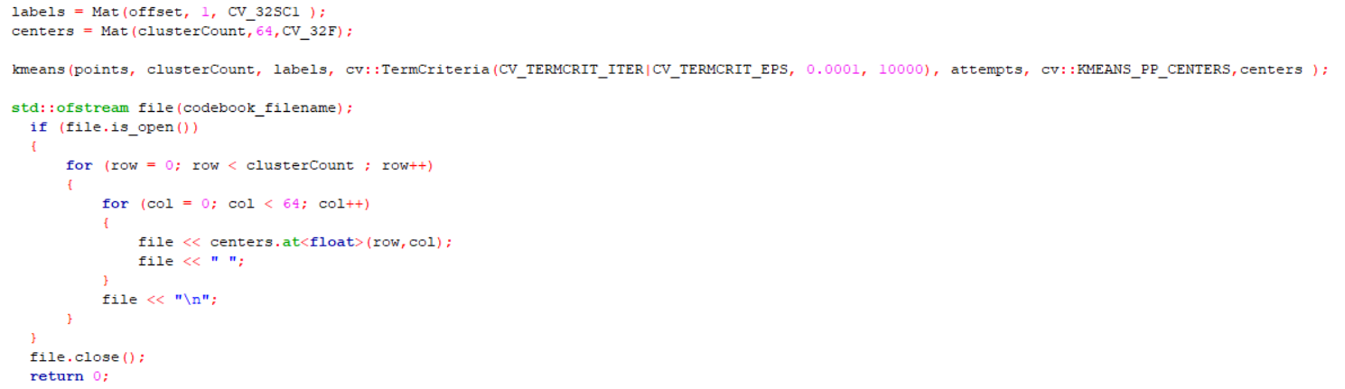
Now we apply K-Means on this “points” Mat obtained from previous step and obtain the codewords which are then stored in codebook.

Slide 32
Writing features
Member functions under HVPartitionRFC class are as under
int read_codebook(const char* codebook_filename,int numCW,int descSize);
int getDescMat( const CvSeq* model_keypoints, const CvSeq* model_descriptors, CvMat* points, int descSize );
int HVPartitionRFC:: ObtainSURFDesc(int descSize);
int HVPartitionRFC:: FindNearestCodeWordED(int index, float &mdist);
int HVPartitionRFC:: ObtainPartition(int h,int v);
int HVPartitionRFC:: ComputeHistFeatures(int index);
int HVPartitionRFC::ComputeHVPFeatures()

Slide 33
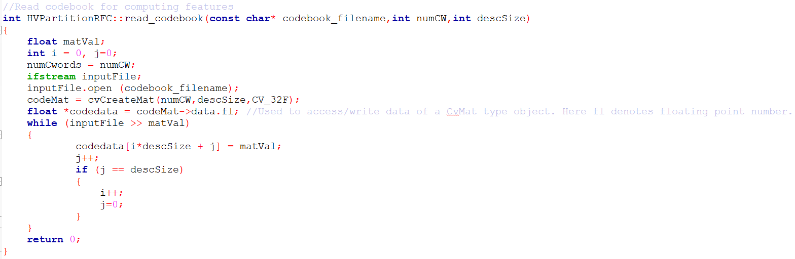
int read_codebook(const char* codebook_filename,int numCW,int descSize);
This function is used to read the codebook made from Step 1(Create CodeBook) and it stores the codewords in a Mat called CodeMat

Slide 34
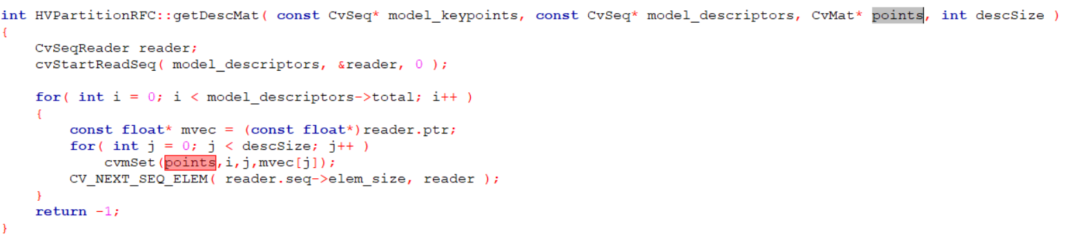
int getDescMat( const CvSeq* model_keypoints, const CvSeq* model_descriptors, CvMat* points, int descSize )
Copies all descriptors of the image under consideration to “points”

Slide 35
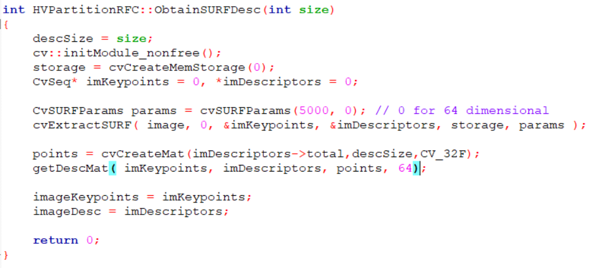
int ObtainSURFDesc(int descSize)
cvExtractSURF function is used to get the descriptors and keypoints of an image and then we call the getDescMat function to store all the descriptors t the “points” Mat.

Slide 36
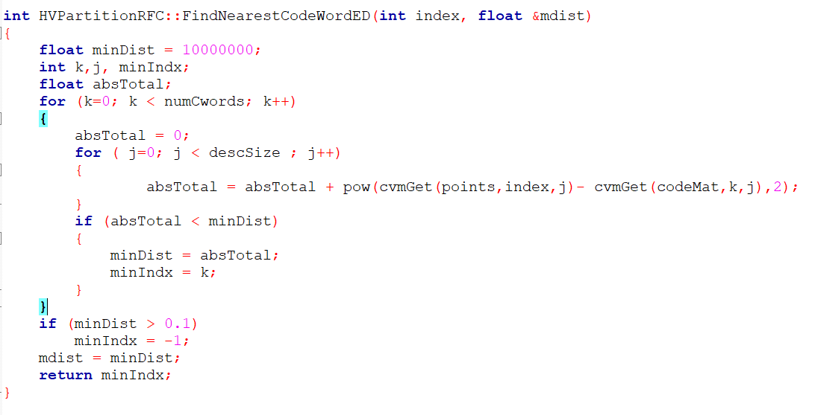
int FindNearestCodeWordED(int index, float &mdist)
Used to find the nearest codeword the particular descriptor (points[index]) of the image belongs to.
This is done by finding the minimum of absolute distance between the descriptor and codewords in the codebook.

Slide 37

int ObtainPartition(int h,int v)
Used to partition the page into 13 partitions.
Stores the partition in two vector of pairs PartitionBound1 and PrtitionBound2
The range of height $∈(PartitionBound1\left[i\right].first, PartitionBound2\left[i\right].first)$
The range of width $∈\left(PartitionBound1\left[i\right].second, PartitionBound2\left[i\right].second\right)$
For e.g. PartitionBound1 = {1,1} and PartitionBound2 = {H,W/2} then
The range of height $∈\left(1, H\right)$
The range of width $∈(1, W/2)$

Slide 38
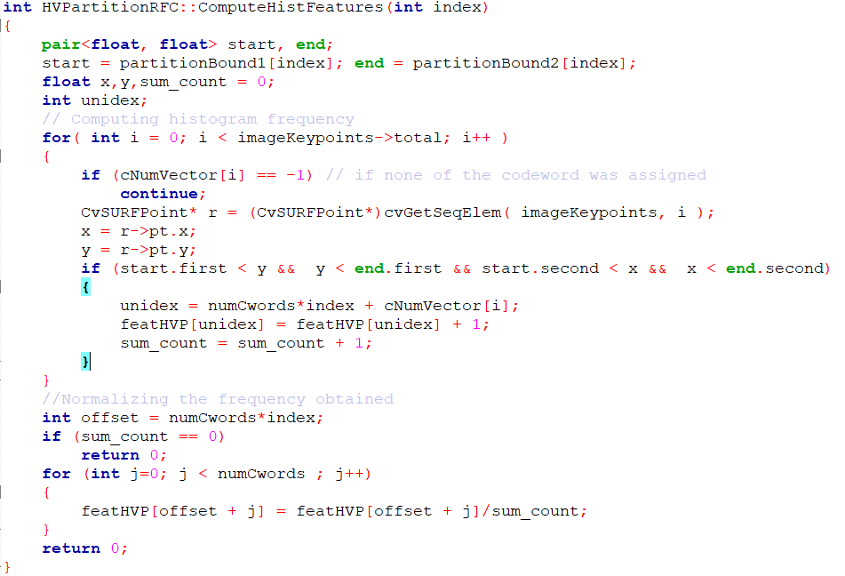
int ComputeHistFeatures(int index)
Computes the histogram by storing the fraction of keypoints ( of the image) in the partition considered (at index = “index”) and storing it in featHVP vector.

Slide 39
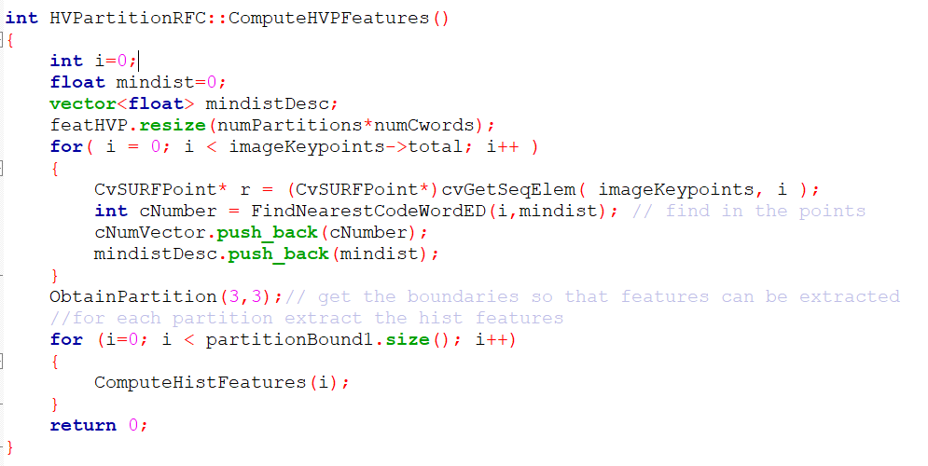
int HVPartitionRFC::ComputeHVPFeatures()
Computes Histogram features for every partition for an image by calling ComputeHistFeatures(int) function.
Also we calculate the cNumVector and mindistDesc vectors where
cNumVector[i] = the cluster number i^{th} keypoint of image belongs to.
mindistDesc[i] = the minimum distance to the codeword in codebook the i^{th} keypoint is.

Slide 40
Cross validation
Using RandForestTrainTest::read_data() store the features (histogram) of the training images in a Mat(), named featMat and class to which those images belong in another Mat(), called data_class.
Now using CvRTrees::train(), train the random forest for the training data.
Predict the class for test images using CvRtrees::predict() and check if they match with the their respective class tags.
Calculate the accuracy and repeat for 10 times.

Slide 41
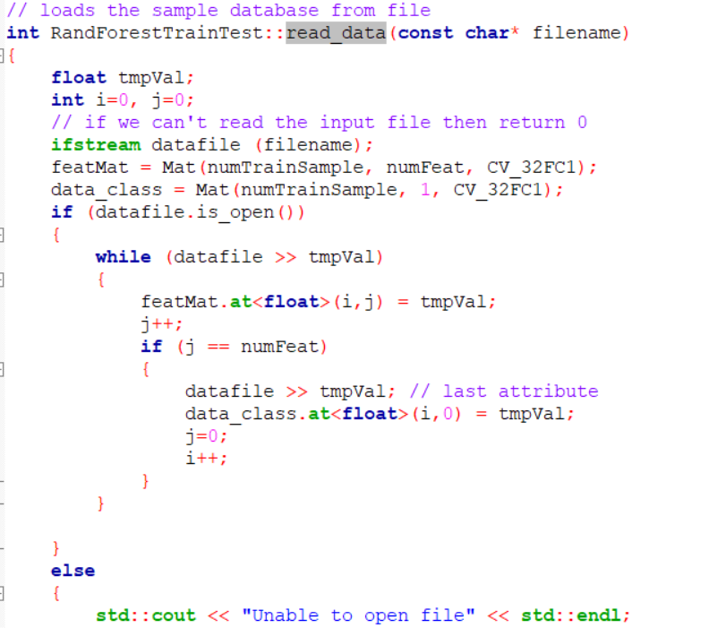

Slide 42
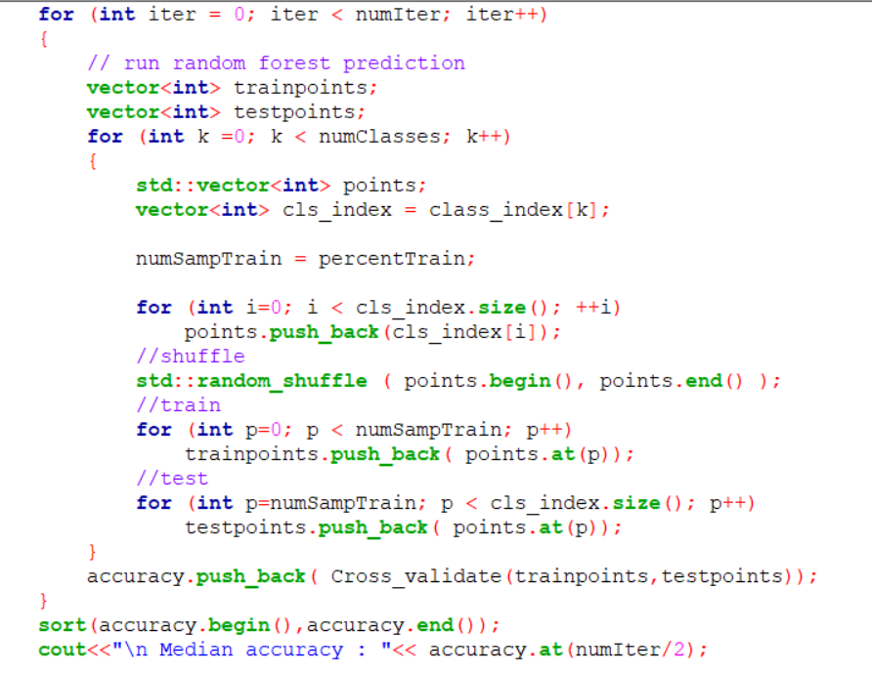

Slide 43
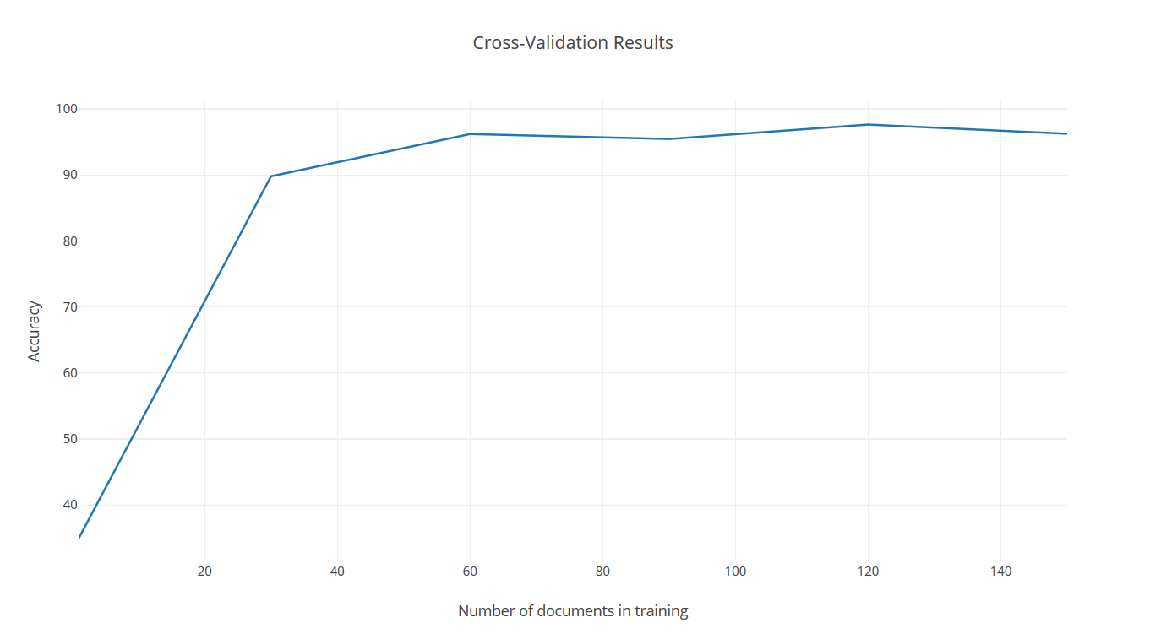

Slide 44
Expected Median Accuracy
(on 150 relevant and 250 irrelevant training data)
97.2%
Obtained Median Accuracy
(on 150 relevant and 150 irrelevant training data)
97.2789

Slide 45
Training the random forest
Using RandForestTrainTest::read_data() store the features (histogram) of the training images in a Mat(), named featMat and class to which those images belong in another Mat(), called data_class.
Using CvRTParams get the set of training parameters for the forest.
Create a forest using CvRTrees.
Train the forest using CvRTrees::train.
We train the tree using the histogram of all images and the result( that is which class they actually belong to) stored in featMat and dataClass repectively
Save the forest in a file named model.txt

Slide 46
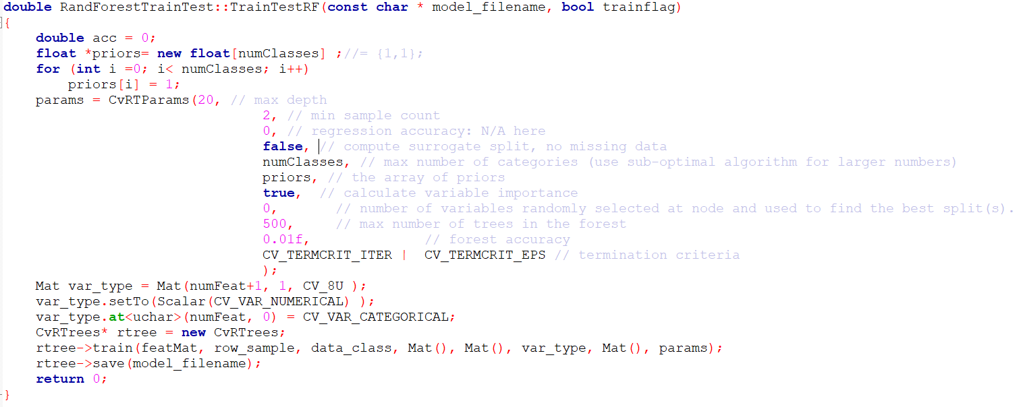

Slide 47
Classification of image
We load the Random forest tree formed in the previous step.
Next we calculate the histogram of the image to be tested.
Now using our CVRTree and histogram of image we classify the image.

Slide 48
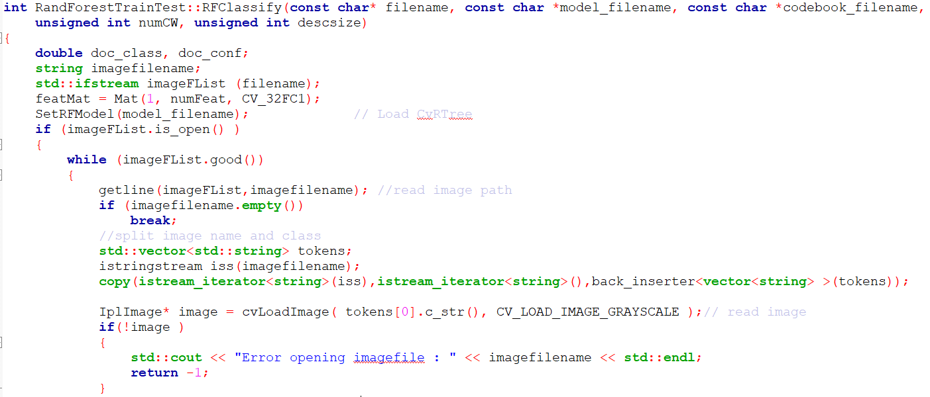

Slide 49
